Slide 1


SAP BTP Training
Cloud Foundry Training

Slide 2

DISCLAIMER
The training content and delivery of this presentation is confidential, and cannot be recorded, or copied and distributed to any third party, without the written consent of Anubhav Trainings

Slide 3

LEARNING OBJECTIVES
SAP BTP CAPM Development
Create DB Tables
Manage Aspects
Create Services
Support for localizations
SAP BTP CAPM Development
Introduction to BAS
Generic Handlers
ACID Properties in Database
Fiori Element – introduction
Free style vs Fiori Element
Annotations in CDS
Develop end to end List Report in BAS

Slide 4
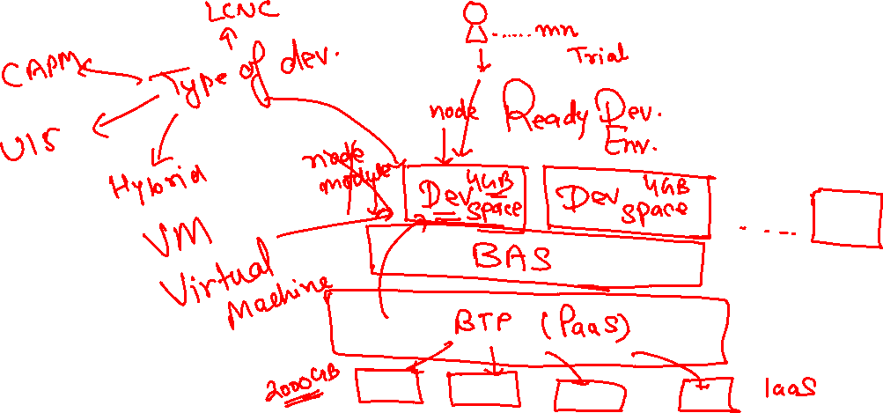
Business Application Studio
SAP Business Application Studio is a development environment available on SAP Business Technology Platform. Before you can start developing using SAP Business Application Studio, administrators must perform the required onboarding steps to create CAPM applications on cloud.
www.anubhavtrainings.com

Slide 5
Challenges for developers in BTP
Approuter Implementation was difficult → It’s a laborious work to setup project and security
What is SAP’s recommendations to build Cloud Native apps in BTP → Best-practice
Are there any gold standard which industry should follow w.r.t. SAP BTP
Many times as a developer, I need to take care of loading all required dependencies
Reusability of code which can speed up my development
As a developer I want to focus more on functionality then the project setup
Tight Coupling to DB or technology
Dependency on SQL
No matter which area we belong SO, PO, MM, PM, PJ, APO, CRM…FI etc.
So to maintain and handover the code, very high time needed
User Interface
Service + API
RAP
Restful ABAP Programming
DB
CREATE COLUMN TABLE tab (
col type, col type,
PRIMARY KEY (col)
)
CREATE TABLE tab{
col1 as TYPE, col2 as TYPE
};
CAPM
Cloud Application Programming Language
www.anubhavtrainings.com

Slide 6
CAPM – Cloud Application Programming Model
CAPM is a framework of languages (Java, NodeJS), libraries (node modules - CDS), and tools (BAS, VSCode, @sap/cds-dk) for building Enterprise grade Cloud-native Applications in SAP BTP.
https://cap.cloud.sap/docs/
Concept of CDS – Core Data & Services
Conceptually CDS is same concept but different flavor. The concept says, that we will have a design time object which is named as CDS File. We will create a .cds file for almost everything e.g. service, db artefact, annotation. This is a design time file and the SAP’s framework (CAPM, RAP), will convert this design time definition after compilation to the runtime object.
CAPM
(CDS Engine)
Node Dependency
Application (package.json)
SQL Code
File.cds (definition)
Entity orders{
Id integer;
Company string;
Amount decimal(12,2);
}
www.anubhavtrainings.com

Slide 7
First CAPM app
Install the CDS-DK (Development Kit), This kit contains the tools required to develop CAPM Application including a command line tool called cds npm install –g @sap/cds-dk
We will create a project folder, navigate inside and generate project skeleton and dependencies cds init needs to be executed inside project directory
Basics of DB
Table
Primary Key
Foreign Key
Join
Check table
Views
Data types
www.anubhavtrainings.com

Slide 8
UI Layer – User experience
MVC architecture + Annotations
Service Layer
Expose data and abstract the information from API
OData services
API Layer – Business logic layer
Application logic, processing, validations, rules, customizing’s, utilize framework, call DB layer
FM, Rep, Classes…
SQL
Database layer
Tables, Constraints, Views, Structure, types, …
+ demo data
SQLite - free
NoSQL

Slide 9
Creating First DB
Add a local database which helps us building and testing CAPM app locally in our computer, using a sqlite database which is free and a file system based database which we can use.
Command – npm install sqlite@3 --save-dev
EPM Data Model = Enterprise procurement Model
Created first datamodel.cds file with database tables
Went to DB folder and run cds complile datamodel.cds -2 sql
Deploy our CDS file to the sqlite DB cds deploy --to sqlite:anubhav.db
We can now install SQLite Command line tool to access
Added the foreign key between db tables.
Product Texts
Addresses
Business Partners
(Customer, Vendor)
1 *
Purchase Orders
Products
1..*
https://www.youtube.com/watch?v=1tk4DUOXXQw
Purchase Order Items
www.anubhavtrainings.com

Slide 10
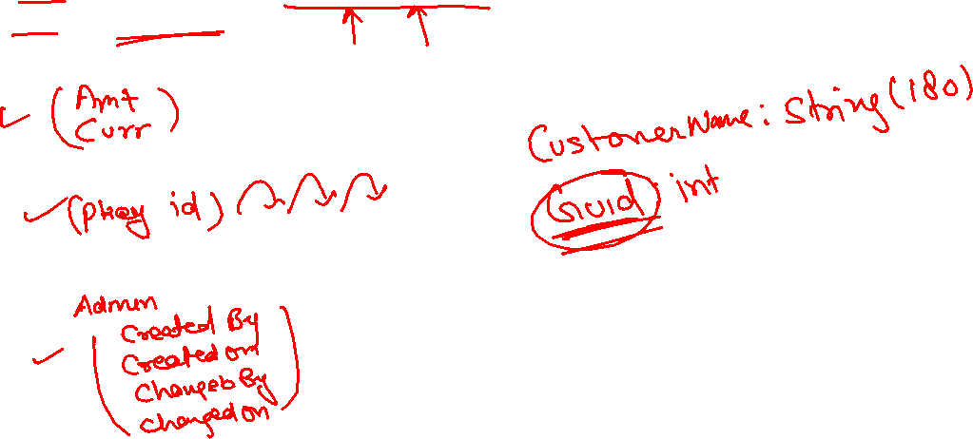
Aspect – Reuse of Types
There are 2 types of aspects
Standard – Provided by SAP @sap/cds/common
Custom – User defined
www.anubhavtrainings.com

Slide 11
Language Dependent Data – text Tables
Following are the dis-advantages of classical technique
We have to manually create the text table
To read data a developer need to code association and also pass the language value manually @ runtime
Why we need views in a software
They display non-normalized data. The data is spread in multiple tables, and it is difficult for developers to every time write JOINs.
The application needs data which is presentable to user
View gives security because users cannot update data using view
They can aggregate data like find total sales per customer.
Expose columns of technical type to more semantic names
www.anubhavtrainings.com

Slide 12





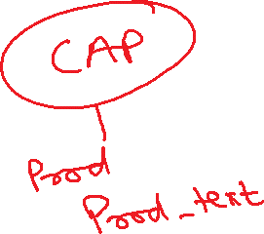




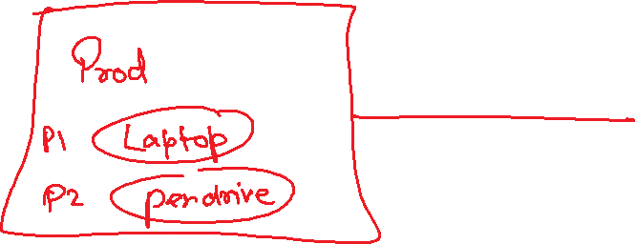

Slide 13
Create EPM Data Model
Product Texts
Addresses
Business Partners
(Customer, Vendor)
1 *
Purchase Orders
Products
1..*
https://www.youtube.com/watch?v=1tk4DUOXXQw
Purchase Order Items
www.anubhavtrainings.com

Slide 14
Language Dependent Data – text Tables
Following are the dis-advantages of classical technique
We have to manually create the text table
To read data a developer need to code association and also pass the language value manually @ runtime
www.anubhavtrainings.com

Slide 15
CDS Views
Why we need views in a software
They display non-normalized data. The data is spread in multiple tables, and it is difficult for developers to every time write JOINs.
The application needs data which is presentable to user
View gives security because users cannot update data using view
They can aggregate data like find total sales per customer.
Expose columns of technical type to more semantic names
www.anubhavtrainings.com

Slide 17
Generic Handlers
The CAPM Framework generates most of the code for CURDQ operations on the entity, it also does these operations in synchronous manner. At time, we want to
Take full control on CURDQ
I want to add my custom validations before data is updated
We want to change data with enrichment
Read data we want to add extra information
When? (on,before,after) – before
Who? - ENTITY - Employee
Operation? – CREATE, UPDATE
What? – Validate if input Sal < 1mn
DB
User/Developer
Service
CAPM Framework
before
on
after
www.anubhavtrainings.com

Slide 18
ACID properties of DB
A – Atomicity
C - Consistency
I - Isolation
D - Durability
OData V4 which is a latest version of OData version 2. SAP released a backward compatible module which converge the V4 capm services to OData v2.
The module is named as @sap/cds-odata-v2-adapter-proxy
www.anubhavtrainings.com

Slide 19

Summarize
LET’S SUMMARISE!

Slide 20

Summarize
End of Day 13

Slide 22


We’re committed to empower you to be
#FutureReady
through powerful training solutions.
We build the workforce of the future.
250+
Corporate Clients
30,000+
Learners Trained
25000+
Learners Placed
FREE WEBINARS
Sign up for free webinars with industry experts every fortnight!
Enroll Now!
Contact us today!
https://anubhavtrainings.com

